Slide 1
Eligible Training Provider Orientation
Originally Delivered: May 24, 2022
Updated: July 28, 2022
Oklahoma Works is an Equal Opportunity Employer/Program. Auxiliary Aids and Services are available upon request to individuals with disabilities. TDD/TYY: 1-800-722-0353

Slide 2
Agenda
The Big Picture
Workforce Innovation and Opportunity Act
Oklahoma Workforce System
Green Country Workforce
Service Provision
The Role of the Training Provider
Provider Eligibility
Program Requirements
Helpful Resources and Next Steps

Slide 3
Workforce Innovation and Opportunity Act (WIOA)
Became law in 2014, expect it to be extended another 6 years
Federal funds dedicated to helping job seekers succeed in the labor market and matching employers with skilled workers
Specifically designed to prioritize serving people with barriers to employment
This includes individuals who are:
Low-income or who receive public assistance
Currently deficient in basic skills
Veterans and their eligible spouses
Living with any type of disability
Involved in the justice system
Immigrants
Youth ages 16-24

Slide 4
Oklahoma Workforce System
Each Local Area Workforce Development Board:
Serves a designated area with unique strengths and needs
Has its own processes and policies in managing WIOA funds for their Area
Identifies a Local Area ETP Registry Administrator
Is monitored by the State Office of Workforce Development (OOWD) for compliance to WIOA regulations

Slide 5
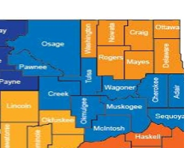
Green Country Workforce
Mission Statement: Green Country Workforce fuels economic development by creating relationships that benefit employers and job seekers by placing talent today, while preparing individuals for the jobs of tomorrow.
Formed through the 2021 merger of Tulsa Area Workforce Development Board and Eastern Workforce Investment Board
Nine centers of operation
5 full-time
4 part-time
TULSA
TAHLEQUAH
WAGONER
STILWELL
MUSKOGEE
SAPULPA
OKMULGEE
Julie Van De Wege
ETP Registry Administrator
Phone: 918-438-7947
jvandewege@greencountryworks.org
SALLISAW
EUFAULA

Slide 6
Center Services
BASIC CAREER SERVICES
Self-directed (no enrollment necessary)
Access to Resource Room (computers, internet, phones, copiers, etc.)
INDIVIDUALIZED SERVICES
Enrollment in the WIOA program
Paired with a Career Coach
Training information for in-demand jobs
Referrals to community agencies and events
Skills assessments
G.E.D. classes and testing
Paid work-based learning opportunities
Registered apprenticeships
Follow-up support
Assistance with tuition, supplies, and other supportive services
A Career Coach determines (after conducting an interview, evaluation, and career planning) that the job seeker needs training services to obtain or retain employment
An Individual Training Account (ITA) is the primary process to obtain training under WIOA
An ITA is a Payment Agreement with an Eligible Training Provider established on behalf of a qualifying participant
The ITA must be documented as the “Funding of Last Resort”

Slide 7
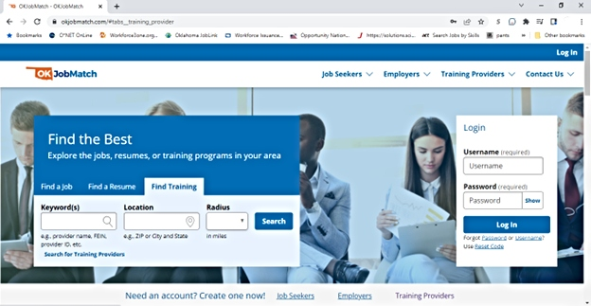
ITA and the ETP Registry
The ETP Registry includes all State approved Eligible Training Providers and their approved programs and is stored/managed on www.OKJobMatch.com
Career Coaches work directly with participants to help them plan and process their Individual Training Accounts using the Registry as a resource
WIOA requires informed customer choice in the selection of a training program
Factors participants consider when choosing a provider include:
Length of the training program
Cost of the training program
Current skill level and ability to complete
Educational background
Class schedules
Transportation
Childcare

Slide 8
Check-In: Questions or Comments?

Slide 9
ETPR Approval Process
State Approval:
Applicants must submit all required information within 60 days from the data of initial application
Local Area Approval (follows State approval):
Recommendation: Apply for a new program at least 60 days in advance
Local Area will re-approve/approve, deny, or remove programs within 30 days
Eligibility Expiration Notice emailed within 45 days – system generated and sent to the email of the Primary Contact listed in your institution’s OKJobMatch.com account
Failure to provide updated information within 30 days after the updated request may result in denial of continued eligibility
Initially, programs are approved for a 1-year period and then reviewed at 2-year intervals
Your Local Area ETPR Administrator is available to answer questions and advise through the application process

Slide 10
Five Types of Eligible Training Providers
• Institutions of higher education that provide programs leading to recognized postsecondary credentials
• Private vocational schools including private educational institutions eligible to receive federal funds under Title IV of the Higher Education Act of 1965
• Other public or private providers of training, which may include community-based organizations (CBOs) and joint labor-management organizations
• Providers of adult education and literacy activities under Title II if provided in combination with occupational skills training
Applicants must meet specific licensing requirements and provide all required information on www.OKJobMatch.com
• Industry Recognized Apprenticeship Programs (IRAPs) and Registered Apprenticeship Programs (RAPs)

Slide 11
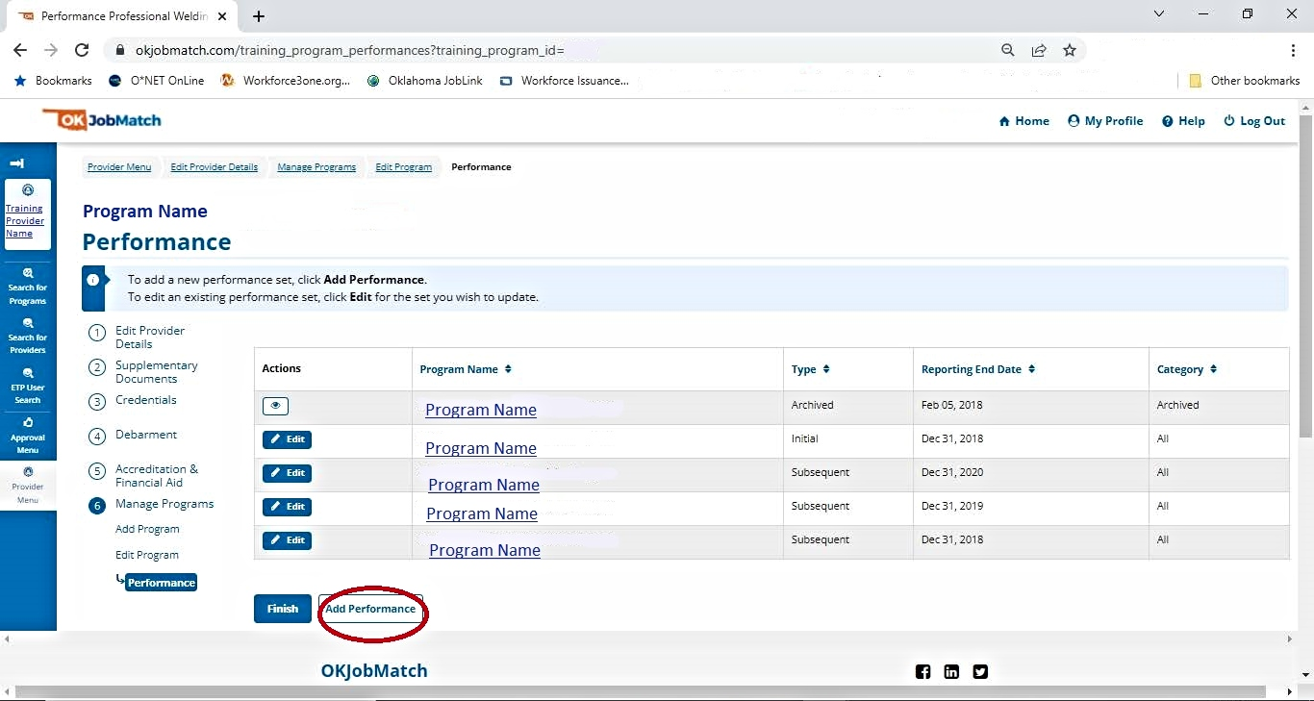
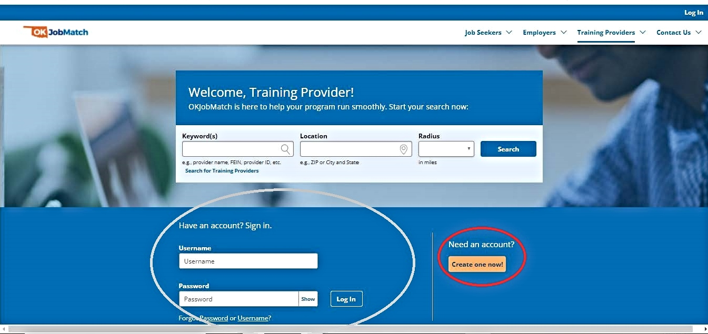
Managing Programs in OKJobMatch.com
Requirements:
Program Information
Recognized Postsecondary Credential
In-State Training Costs
Association with a Demand Occupation
Performance Data
Required for Initial & Subsequent Approval
Supplemental Wage Data Collection
Per WIOA, formal Registered Apprenticeship Programs (RAPs) are automatically eligible for the ETPR

Slide 12
Recognized Postsecondary Credential
Course(s) or a structured regimen that leads to a recognized postsecondary credential, which is defined by WIOA as:
A credential consisting of an industry-recognized certificate/certification
A certificate of completion of a registered apprenticeship (not applicable for any other type of training)
A license recognized by the State or Federal Government, or
An associate or baccalaureate degree

Slide 13
Program Information
Prerequisites
Training Schedule
Program Name and Synopsis
Single or Multiple Courses
Financial Aid Offered
Associated SOC Code
Method of Delivery
Name of Credential
Program Cost
Type of Credential
ZIP Code and County
Total Credit Hours

Slide 14
Performance Data
Field | Description
Performance Type | Annual or Continued
Student Type | ALWAYS select “Overall”; NEVER select “WIOA”
Begin Date & End Date | MM, DD, YYYY Format
# Served | Number of students enrolled in the program during the reporting period
# Exited | Total number of students who completed, withdrew, or transferred from the program during the reporting period
# Completed | Total number of students who successfully completed the program during the program year
# Employed 2nd Quarter After Exit | Number of students who were employed in the 2nd quarter after leaving the program
# Employed 4th Quarter After Exit | Number of students who were employed in the 4th quarter after leaving the program
# Who Attained Credentials | Number of students who earned credential(s) upon completion of the program
Performance Data is Required for Initial & Subsequent Programs

Slide 15
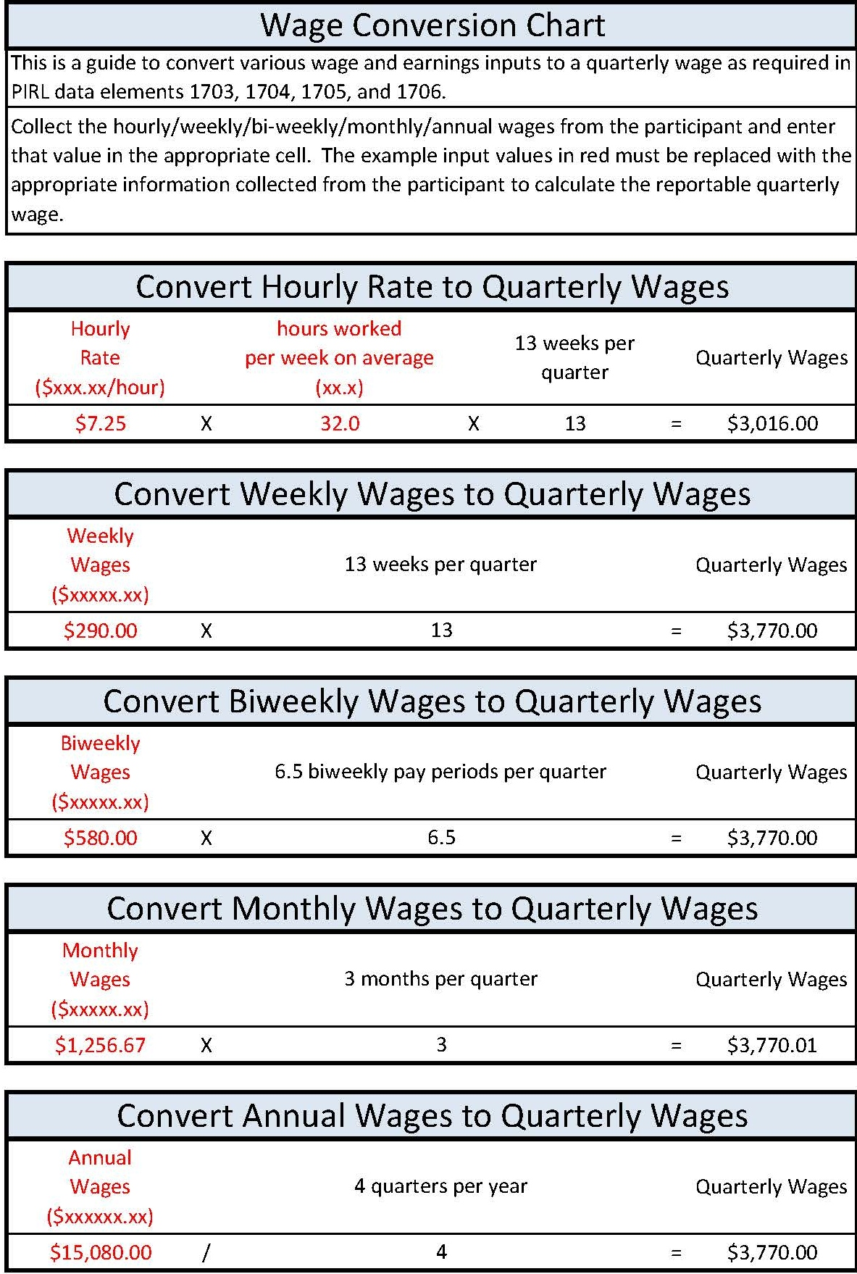
Performance Data (cont.)
Field | Description
Median Earnings in 2nd Quarter After Exit | The median quarterly wage students earned in the 2nd quarter after leaving the program.
Average Earnings in 2nd Quarter After Exit | The average quarterly wage students earned in the 2nd quarter after leaving the program.
Average Earnings in 4th Quarter After Exit | The average quarterly wage students earned in the 4th quarter after leaving the program.

Slide 16
Program Performance - Wage Data Collection
Training Providers may collect wage data from sources including (but not limited to):
Copies of quarterly tax payment forms, such as a Form 941 (Employer’s Quarterly Tax Return)
Copies of paystubs
A signed letter from an employer on company letterhead, attesting to an individual’s employment status and earnings
Follow-up survey (self-reported) with students
Income earned from similar positions per tools such as EMSI or O*Net
Self-employment worksheets signed and attested to by students

Slide 17
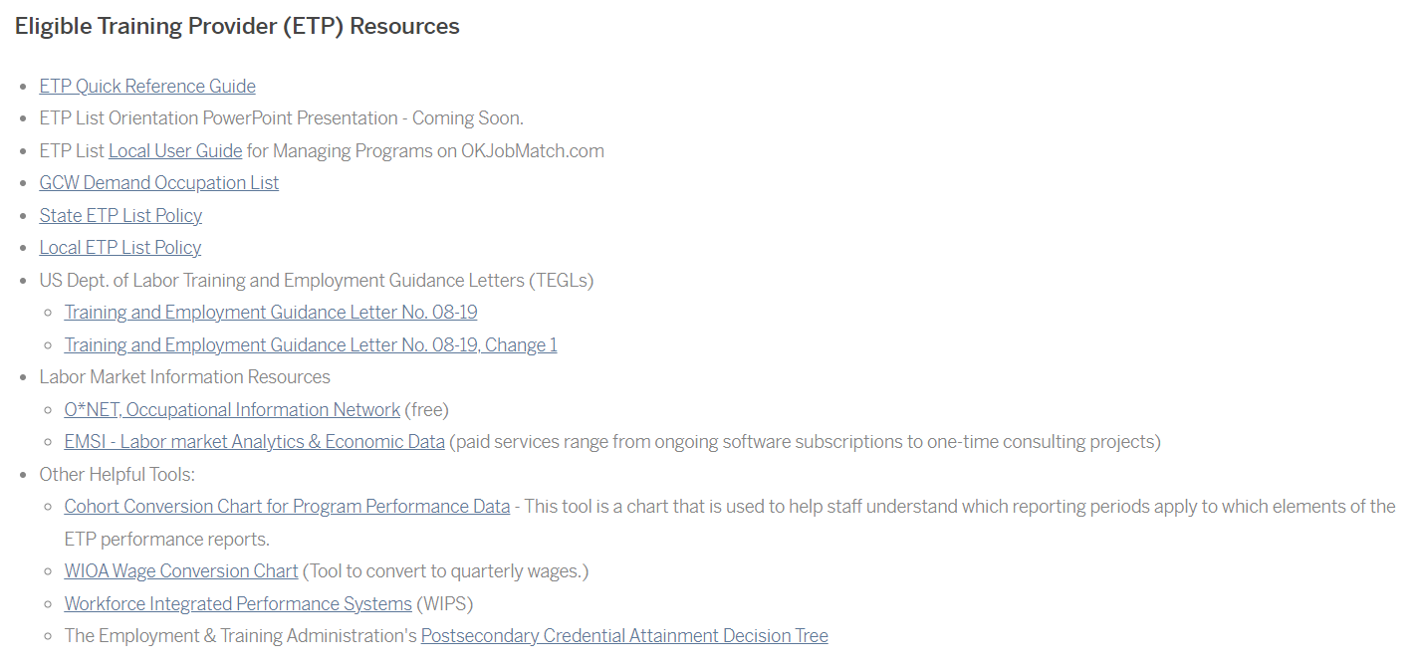
On-Line Resources
greencountryworks.org

Slide 18
Check-In: Questions or Comments?

Slide 19
Next Steps
Please provide feedback on this Orientation session
What was helpful?
What was not helpful?
What is missing?
Please review the on-line resources and provide the same feedback!
Quarterly check-ins will begin during the month of September
Stay informed – follow Green Country on social media!
https://www.facebook.com/greencountryworks
https://www.linkedin.com/company/workforce-greencountry
https://www.instagram.com/greencountryworks/

Slide 20
THANK YOU!
The success of our mission depends on all of us working together – we appreciate everything you do to make that happen!

